Slide 1
Introduction to Regression Analysis
Regression analysis is used to:
Predict the value of a dependent variable based on the value of at least one independent variable
Explain the impact of changes in an independent variable on the dependent variable
Dependent variable: the variable we wish to predict
or explain
Independent variable: the variable used to explain the dependent variable

Slide 2
Simple Linear Regression Model
Only one independent variable, X
Relationship between X and Y is described by a linear function
Changes in Y are assumed to be caused by changes in X

Slide 3
Simple Linear Regression Model
Population Slope Coefficient
Population Y intercept
Independent Variable
Dependent Variable
Linear component

Slide 4
Y = β₁ + β₂X + ϵ
β₁ is the intercept and β₂ is the slope.
Collectively, they are called regression coefficients.
ϵ is the error term, the part of Y the regression model is unable to explain.

Slide 5
Simple Linear Regression Equation (Prediction Line)
The simple linear regression equation provides an estimate of the population regression line
Estimated (or predicted) Y value for observation i
Estimate of the regression intercept
Estimate of the regression slope
Value of X for observation i

Slide 6

Simple Linear Regression Example
A real estate agent wishes to examine the relationship between the selling price of a home and its size (measured in square feet)
A random sample of 10 houses is selected
Dependent variable (Y) = house price in $1000s
Independent variable (X) = square feet

Slide 7
Sample Data for House Price Model
House Price in $1000s (Y) | Square Feet (X)
245 | 1400
312 | 1600
279 | 1700
308 | 1875
199 | 1100
219 | 1550
405 | 2350
324 | 2450
319 | 1425
255 | 1700

Slide 8
Graphical Presentation
House price model: scatter plot

Slide 9
Excel Output
Regression Statistics
Multiple R | 0.76211
R Square | 0.58082
Adjusted R Square | 0.52842
Standard Error | 41.33032
Observations | 10
ANOVA | df | SS | MS | F | Significance F
Regression | 1 | 18934.9348 | 18934.9348 | 11.0848 | 0.01039
Residual | 8 | 13665.5652 | 1708.1957
Total | 9 | 32600.5000
 | Coefficients | Standard Error | t Stat | P-value | Lower 95% | Upper 95%
Intercept | 98.24833 | 58.03348 | 1.69296 | 0.12892 | -35.57720 | 232.07386
Square Feet | 0.10977 | 0.03297 | 3.32938 | 0.01039 | 0.03374 | 0.18580
The regression equation is:

Slide 10
Graphical Presentation
House price model: scatter plot and regression line
Slope
= 0.10977
Intercept
= 98.248

Slide 11
Interpretation of the Intercept, b₀
b₀ is the estimated average value of Y when the value of X is zero (if X = 0 is in the range of observed X values)
Here, no houses had 0 square feet, so b₀ = 98.24833 just indicates that, for houses within the range of sizes observed, $98,248.33 is the portion of the house price not explained by square feet

Slide 12
Interpretation of the Slope Coefficient, b₁
b₁ measures the estimated change in the average value of Y as a result of a one-unit change in X
Here, b₁ = .10977 tells us that the average value of a house increases by .10977($1000) = $109.77, on average, for each additional one square foot of size

Slide 13
Predictions using Regression Analysis
Predict the price for a house with 2000 square feet:
The predicted price for a house with 2000 square feet is 317.85($1,000s) = $317,850

Slide 14
Coefficient of Determination, r²
The coefficient of determination is the portion of the total variation in the dependent variable that is explained by variation in the independent variable
The coefficient of determination is also called r-squared and is denoted as r²
note:

Slide 15
Graphical Analysis
To predict Distance (dist) by establishing a statistically significant linear relationship with Speed (speed).
Scatter plot: Visualize the linear relationship between the predictor and response
Box plot: To spot any outlier observations in the variable. Having outliers in your predictor can drastically affect the predictions as they can easily affect the direction/slope of the line of best fit.
Density plot: To see the distribution of the predictor variable. Ideally, a close to normal distribution (a bell shaped curve), without being skewed to the left or right is preferred. Let us see how to make each one of them.

Slide 16
Correlation
Correlation is a statistical measure that suggests the level of linear dependence between two variables, that occur in pair – just like what we have here in speed and dist. Correlation can take values between -1 to +1.
If we observe for every instance where speed increases, the distance also increases along with it, then there is a high positive correlation between them and therefore the correlation between them will be closer to 1.
The opposite is true for an inverse relationship, in which case, the correlation between the variables will be close to -1.

Slide 17
A value closer to 0 suggests a weak relationship between the variables.
A low correlation (-0.2 < x < 0.2) probably suggests that much of variation of the response variable (Y) is unexplained by the predictor (X), in which case, we should probably look for better explanatory variables.
cor(cars$speed, cars$dist)
0.8068949

Slide 18
Build Linear Model
The function used for building linear models is lm().
The lm() function takes in two main arguments, namely:
1. Formula
2. Data.
The data is typically a data.frame and the formula is a object of class formula.
The most common convention is to write out the formula directly in place of the argument

Slide 19
linearMod <- lm(dist ~ speed, data=cars) # build linear regression model on full data
print(linearMod)
#> Call:
#> lm(formula = dist ~ speed, data = cars)
#>
#> Coefficients:
#> (Intercept) speed
#> -17.579 3.932

Slide 20
dist = Intercept + (β ∗ speed) => dist = −17.579 + 3.932∗speed

Slide 21
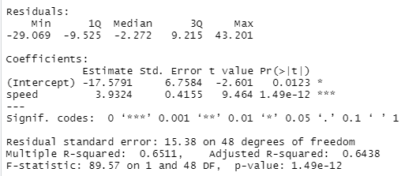
Linear Regression Diagnostics
summary(linearMod)
Notes:
Now the linear model is built and we have a formula that we can use to predict the dist value if a corresponding speed is known. Is this enough to actually use this model? NO! Before using a regression model, you have to ensure that it is statistically significant. How do you ensure this? Lets begin by printing the summary statistics for linearMod.

Slide 22
The p Value: Checking for statistical significance
The model p-Value (bottom last line) and the p-Value of individual predictor variables (extreme right column under ‘Coefficients’).
a linear model to be statistically significant only when both these p-Values are less that the pre-determined statistical significance level, which is ideally 0.05.
This is visually interpreted by the significance stars at the end of the row. The more the stars beside the variable’s p-Value, the more significant the variable.

Slide 23
Null and alternate hypothesis
In Linear Regression, the Null Hypothesis is that the coefficients associated with the variables is equal to zero.
The alternate hypothesis is that the coefficients are not equal to zero (i.e. there exists a relationship between the independent variable in question and the dependent variable).

Slide 24
t-value
A larger t-value indicates that it is less likely that the coefficient is not equal to zero purely by chance. So, higher the t-value, the better.
Pr(>|t|) or p-value is the probability that you get a t-value as high or higher than the observed value when the Null Hypothesis (the β coefficient is equal to zero or that there is no relationship) is true. So if the Pr(>|t|) is low, the coefficients are significant (significantly different from zero). If the Pr(>|t|) is high, the coefficients are not significant.

Slide 26
What this means to us?
When p Value is less than significance level (< 0.05), we can safely reject the null hypothesis that the co-efficient β of the predictor is zero.
In our case, linearMod, both these p-Values are well below the 0.05 threshold, so we can conclude our model is indeed statistically significant.

Slide 27
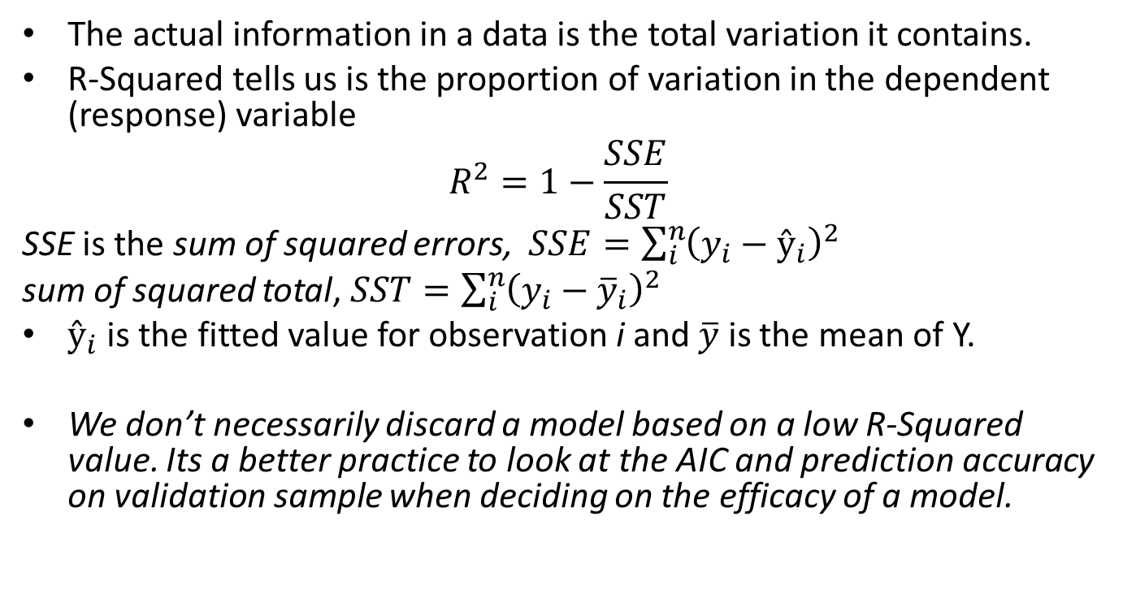
R-Squared and Adj R-Squared
The actual information in a data is the total variation it contains.
R-Squared tells us is the proportion of variation in the dependent (response) variable
$$R^{2}=1−\frac{SSE}{SST}$$
SSE is the sum of squared errors, $SSE=\sum_{i}^{n}{{\left(y_{i}−ŷ_{i}\right)}^{2}}$
sum of squared total, $SST=\sum_{i}^{n}{{\left(y_{i}−{\overline{y}}_{i}\right)}^{2}}$
$ŷ_{i}$ is the fitted value for observation i and $\overline{y}$ is the mean of Y.
We don’t necessarily discard a model based on a low R-Squared value. Its a better practice to look at the AIC and prediction accuracy on validation sample when deciding on the efficacy of a model.

Slide 28
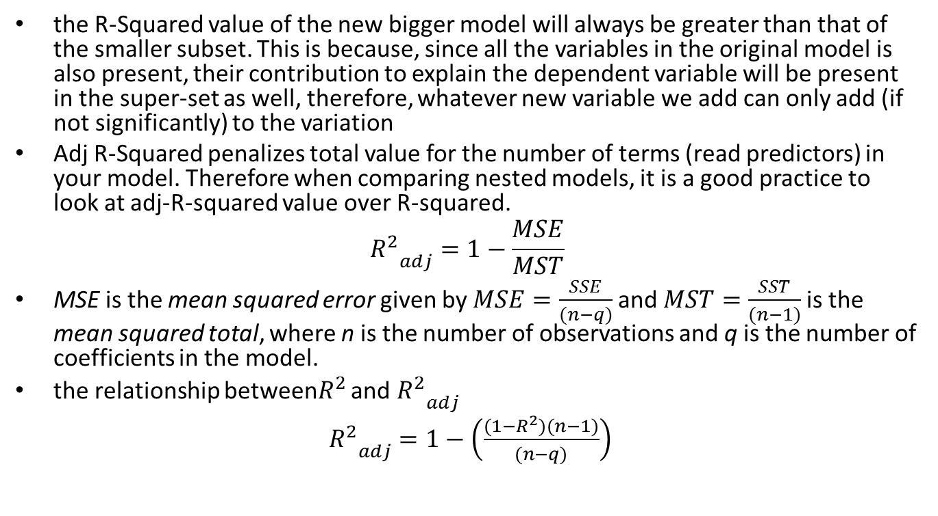
Adjusted R-Squared
the R-Squared value of the new bigger model will always be greater than that of the smaller subset. This is because, since all the variables in the original model is also present, their contribution to explain the dependent variable will be present in the super-set as well, therefore, whatever new variable we add can only add (if not significantly) to the variation
Adj R-Squared penalizes total value for the number of terms (read predictors) in your model. Therefore when comparing nested models, it is a good practice to look at adj-R-squared value over R-squared.
$${R_{}^{2}}_{adj}^{}=1−\frac{MSE}{MST}$$
MSE is the mean squared error given by$MSE=\frac{SSE}{(n−q)}$and $MST=\frac{SST}{(n−1)}$is the mean squared total, where n is the number of observations and q is the number of coefficients in the model.
the relationship between$R_{}^{2}$ and ${R_{}^{2}}_{adj}^{}$
${R_{}^{2}}_{adj}^{}=1−\left(\frac{(1−R_{}^{2})(n−1)}{(n−q)}\right)$

Slide 29
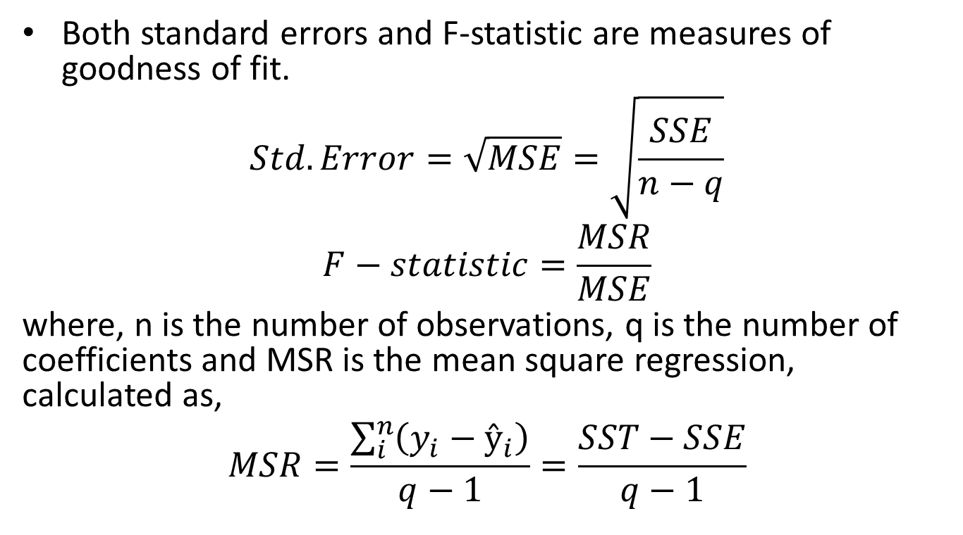
Standard Error and F-Statistic
Both standard errors and F-statistic are measures of goodness of fit.
$$Std.Error=\sqrt{MSE}=\sqrt{\frac{SSE}{n−q}}$$
$$F−statistic=\frac{MSR}{MSE}$$
where, n is the number of observations, q is the number of coefficients and MSR is the mean square regression, calculated as,
$$MSR=\frac{\sum_{i}^{n}{\left(y_{i}−ŷ_{i}\right)}}{q−1}=\frac{SST−SSE}{q−1}$$

Slide 30
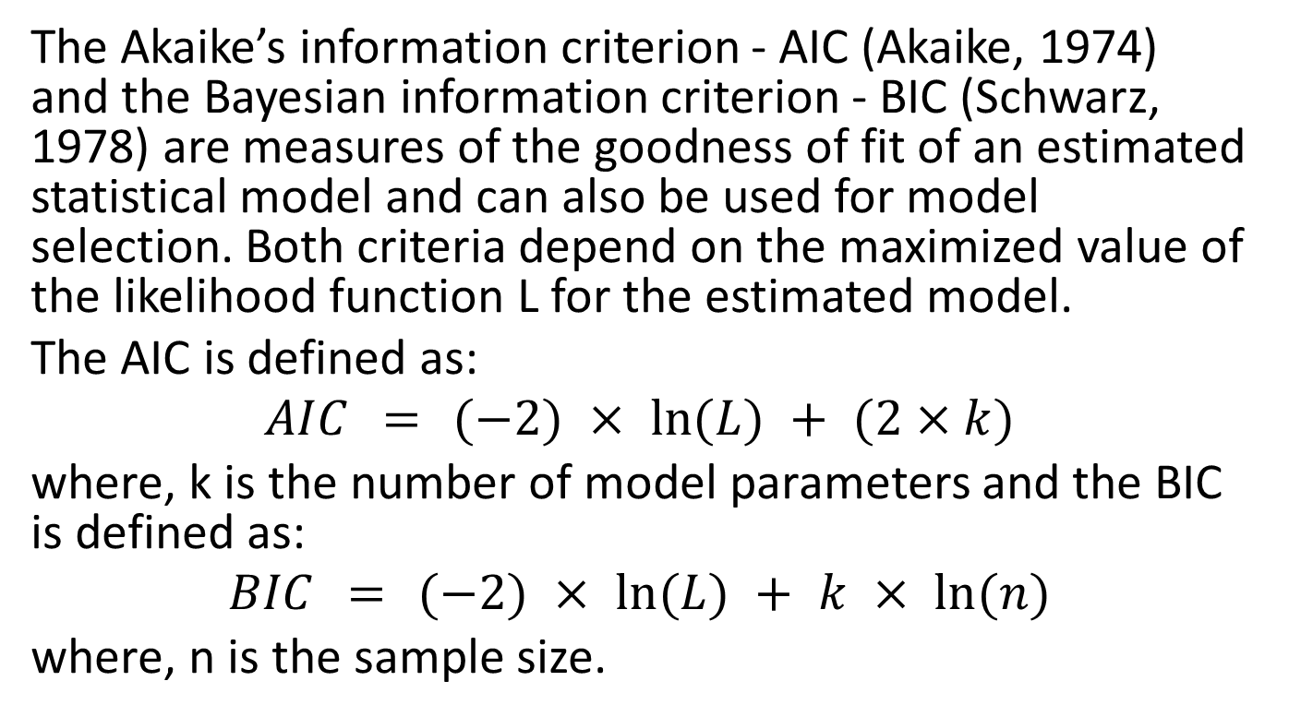
AIC and BIC
The Akaike’s information criterion - AIC (Akaike, 1974) and the Bayesian information criterion - BIC (Schwarz, 1978) are measures of the goodness of fit of an estimated statistical model and can also be used for model selection. Both criteria depend on the maximized value of the likelihood function L for the estimated model.
The AIC is defined as:
$$AIC = (−2) × ln⁡(L) + (2×k)$$
where, k is the number of model parameters and the BIC is defined as:
$$BIC = (−2) × ln⁡(L) + k × ln⁡(n)$$
where, n is the sample size.

Slide 31
For model comparison, the model with the lowest AIC and BIC score is preferred.
AIC(linearMod) # AIC => 419.1569 BIC(linearMod) # BIC => 424.8929

Slide 32
How to know if the model is best fit for your data?
STATISTIC | CRITERION
R-Squared | Higher the better (> 0.70)
Adj R-Squared | Higher the better
F-Statistic | Higher the better
Std. Error | Closer to zero the better
t-statistic | Should be greater 1.96 for p-value to be less than 0.05
AIC | Lower the better
BIC | Lower the better
Mallows cp | Should be close to the number of predictors in model
MAPE (Mean absolute percentage error) | Lower the better
MSE (Mean squared error) | Lower the better
Min_Max Accuracy => mean(min(actual, predicted)/max(actual, predicted)) | Higher the better

Slide 33
Predicting Linear Models
So far we have seen how to build a linear regression model using the whole dataset. If we build it that way, there is no way to tell how the model will perform with new data. So the preferred practice is to split your dataset into a 80:20 sample (training:test), then, build the model on the 80% sample and then use the model thus built to predict the dependent variable on test data.
Doing it this way, we will have the model predicted values for the 20% data (test) as well as the actuals (from the original dataset). By calculating accuracy measures (like min_max accuracy) and error rates (MAPE or MSE), we can find out the prediction accuracy of the model. Now, lets see how to actually do this..

Slide 34
Step 1: Create the training (development) and test (validation) data samples from original data.
# Create Training and Test data –
set.seed(100) # setting seed to reproduce results of random sampling
trainingRowIndex <- sample(1:nrow(cars), 0.8*nrow(cars)) # row indices for training data
trainingData <- cars[trainingRowIndex, ] # model training data
testData <- cars[-trainingRowIndex, ] # test data

Slide 35
Step 2: Develop the model on the training data and use it to predict the distance on test data
# Build the model on training data -
lmMod <- lm(dist ~ speed, data=trainingData) # build the model
distPred <- predict(lmMod, testData) # predict distance

Slide 36
Step 3: Review diagnostic measures.
summary (lmMod) # model summary
#> Call:
#> lm(formula = dist ~ speed, data = trainingData)
#> #> Residuals:
#> Min 1Q Median 3Q Max
#> -23.350 -10.771 -2.137 9.255 42.231
#> #> Coefficients:
#> Estimate Std. Error t value Pr(>|t|)
#> (Intercept) -22.657 7.999 -2.833 0.00735 **
#> speed 4.316 0.487 8.863 8.73e-11 ***
#> ---
#> Signif. codes: 0 '***' 0.001 '**' 0.01 '*' 0.05 '.' 0.1 ' ' 1
#>
#> Residual standard error: 15.84 on 38 degrees of freedom
#> Multiple R-squared: 0.674, Adjusted R-squared: 0.6654
#> F-statistic: 78.56 on 1 and 38 DF, p-value: 8.734e-11
AIC (lmMod) # Calculate akaike information criterion
#> [1] 338.4489
Notes:
From the model summary, the model p value and predictor’s p value are less than the significance level, so we know we have a statistically significant model. Also, the R-Sq and Adj R-Sq are comparative to the original model built on full data.

Slide 37
Step 4: Calculate prediction accuracy and error rates
A simple correlation between the actuals and predicted values can be used as a form of accuracy measure. A higher correlation accuracy implies that the actuals and predicted values have similar directional movement, i.e. when the actuals values increase the predicteds also increase and vice-versa.
actuals_preds <- data.frame(cbind(actuals=testData$dist, predicteds=distPred)) # make actuals_predicteds dataframe.
correlation_accuracy <- cor(actuals_preds) # 82.7%
head(actuals_preds)
#> actuals predicteds
#> 1 2 -5.392776
#> 4 22 7.555787
#> 8 26 20.504349
#> 20 26 37.769100
#> 26 54 42.085287
#> 31 50 50.717663

Slide 38
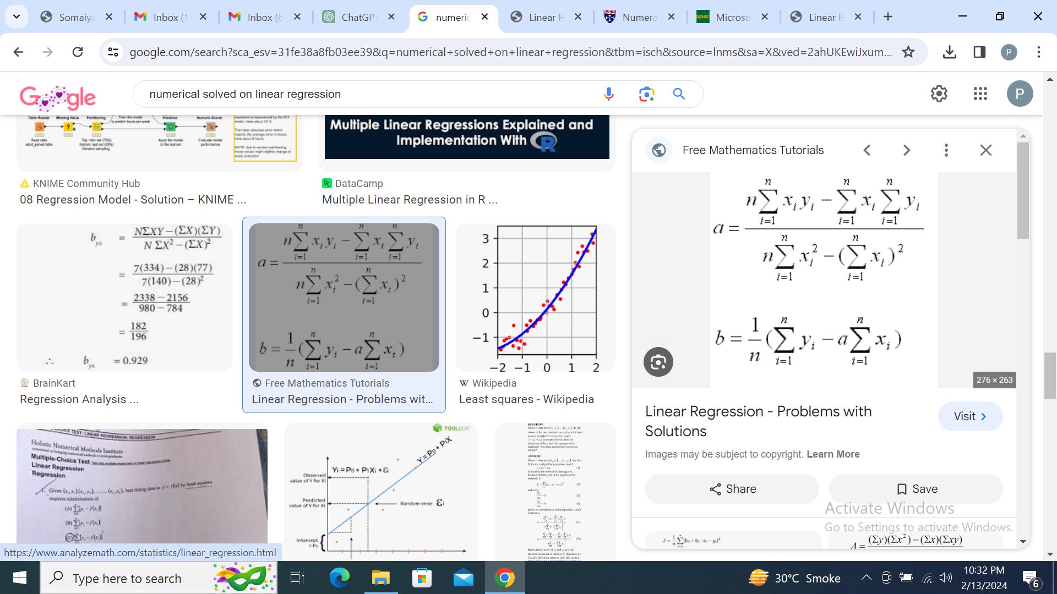
Linear Regression Numerical
The formulas for calculating the slope (a) and y-intercept (b) in simple linear regression are given by

Slide 39
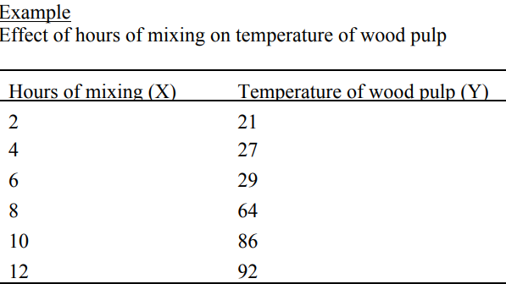
Numerical On Linear Regression
Find the regression equation

Slide 40
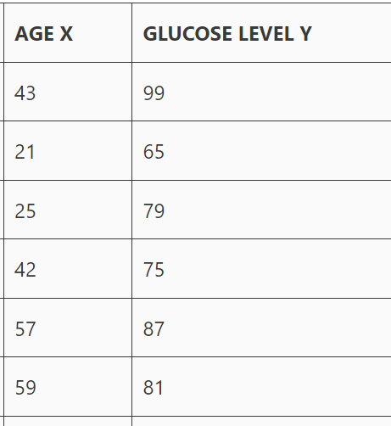
Example No.2 Following table shows the persons age and their respective glucose level. Apply the linear regression and find the equation of line.

Slide 41
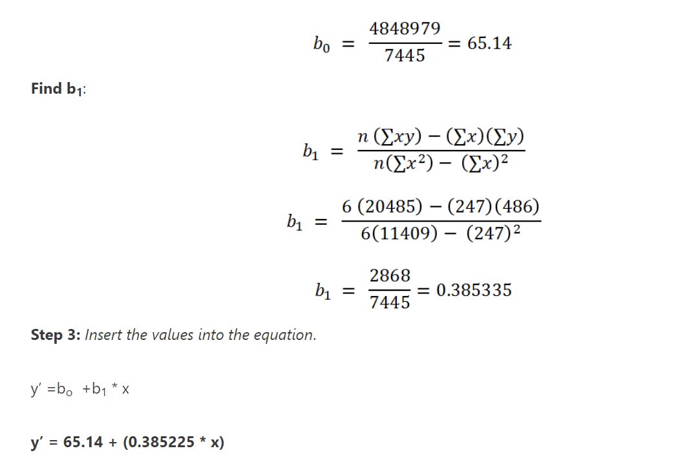
Answer Exp No. 2

Slide 42
Question
?

